Slide 1
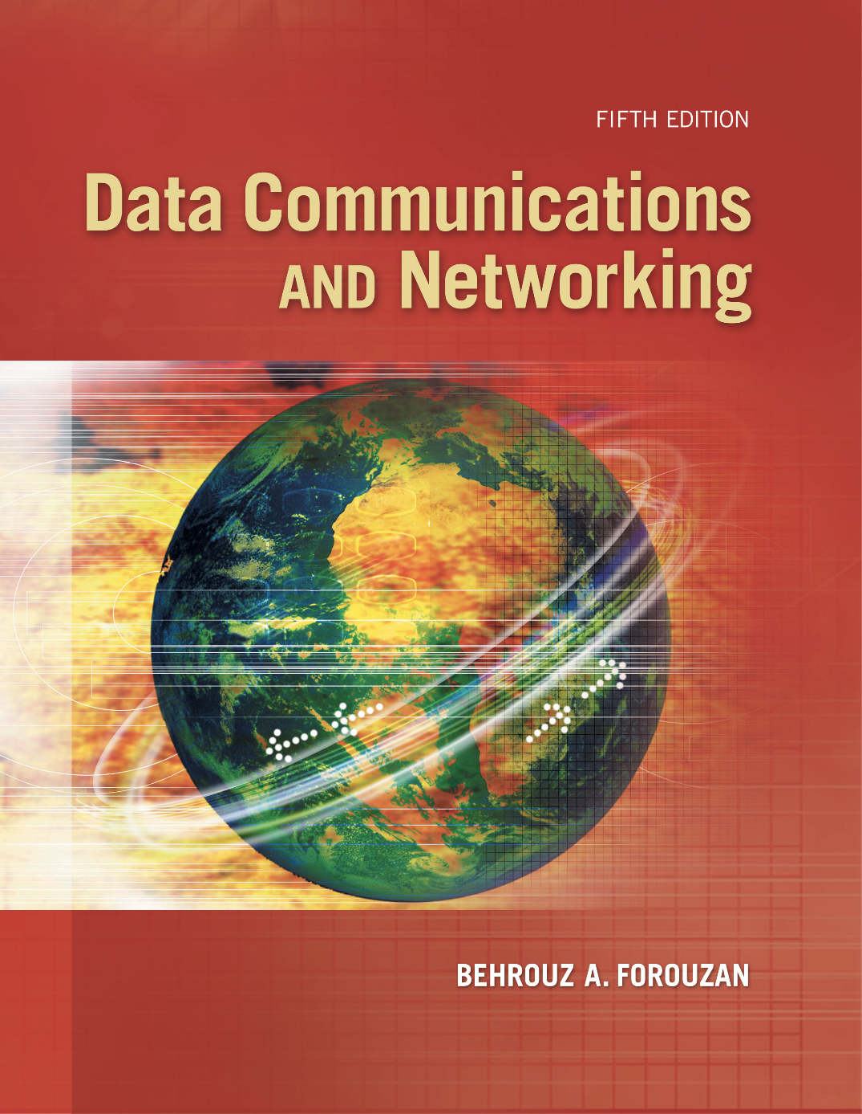
Chapter 18
Introduction to
Network
Layer
Copyright © The McGraw-Hill Companies, Inc. Permission required for reproduction or display.
Notes:
1

Slide 2
Chapter 18: Outline
18.1 NETWORK-LAYER SERVICES
18.2 PACKET SWITCHING
18.3 NETWORK-LAYER PERFORMANCE
18.4 IPv4 ADDRESSES
18.5 FORWARDING OF IP PACKETS
Notes:
18.#

Slide 3

Chapter 18: Objective
The first section introduces the network layer by defining the services provided by this layer. It first discusses packetizing. It then describes forwarding and routing and compares the two. The section then briefly explains the other services such as flow, error, and congestion control.
The second section discusses packet switching, which occurs at the network layer. The datagram approach and the virtual-circuit approach of packet switching are described in some detail in this section.
The third section discusses network-layer performance. It describes different delays that occur in network-layer communication. It also mentions the issue of packet loss. Finally, it discusses the issue of congestion control at the network layer.
Notes:
18.#

Slide 4
Chapter 18: Objective (continued)
The fourth section discusses IPv4 addressing, probably the most important issue in the network layer. It first describes the address space. It then briefly discusses classful addressing, which belongs to the past but is useful in understanding classless addressing. The section then moves to classless addressing and explains several issues related to this topic. It then discusses DHCP, which can be used to dynamically assign addresses in an organization. Finally, the section discusses NAT, which can be used to relieve the shortage of addresses to some extent.
The fifth section discusses forwarding of network-layer packets. It first shows how forwarding can be done based on the destination address in a packet. It then discusses how forwarding can be done using a label.
Notes:
18.#

Slide 5
18-1 NETWORK-LAYER SERVICES
Before discussing the network layer in the Internet today, let’s briefly discuss the network-layer services that, in general, are expected from a network-layer protocol. Figure 18.1 shows the communication between Alice and Bob at the network layer. This is the same scenario we used in Chapters 3 and 9 to show the communication at the physical and the data-link layers, respectively.
18.5
Notes:
18.#

Slide 6
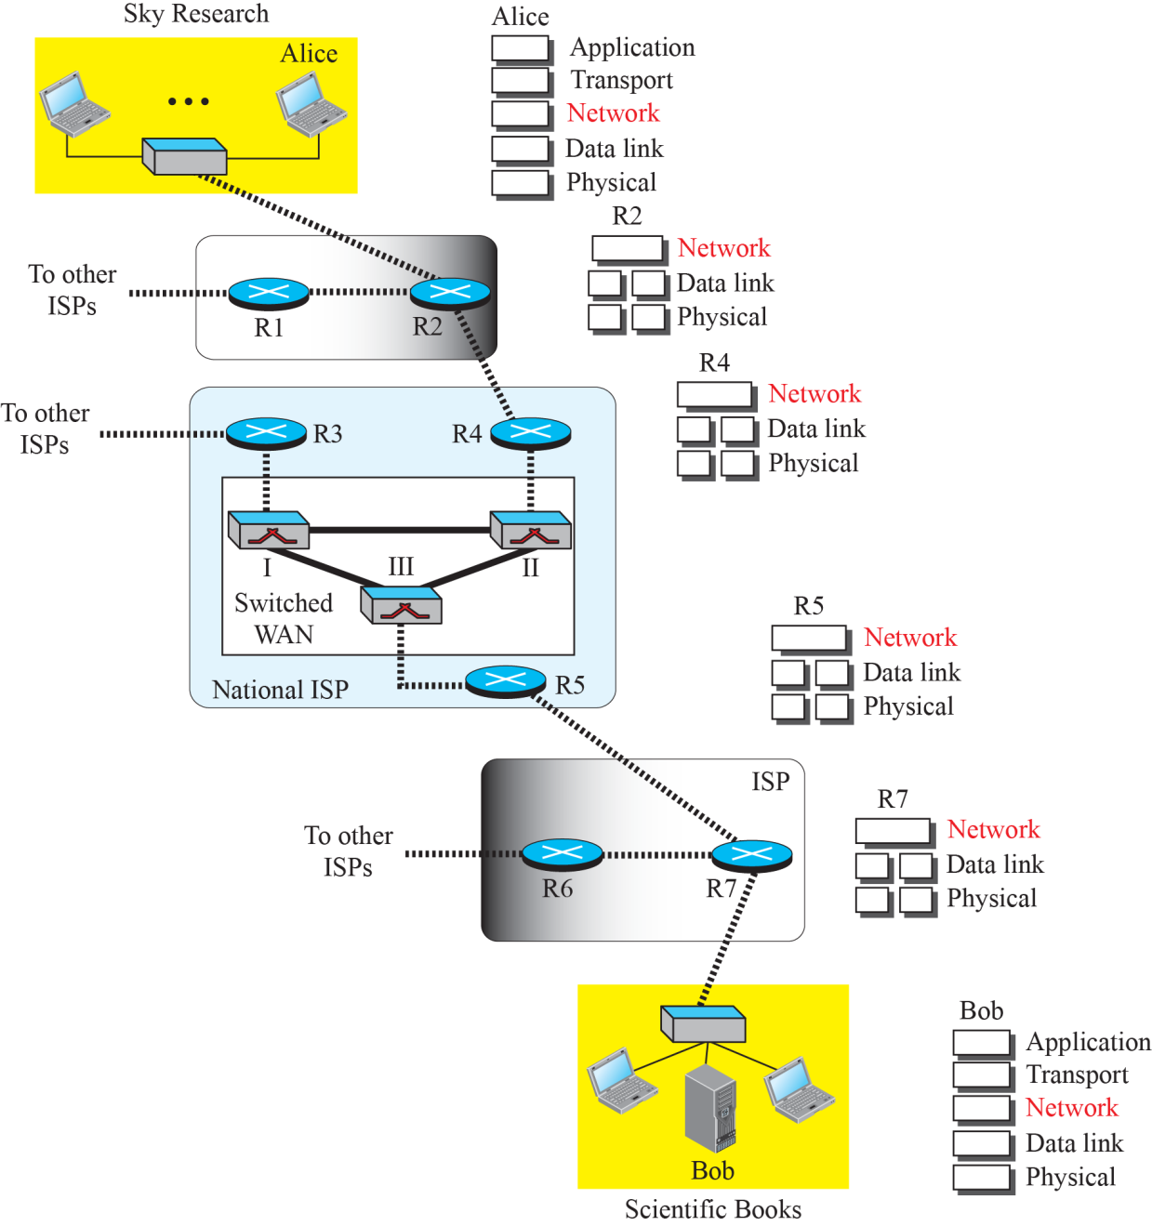
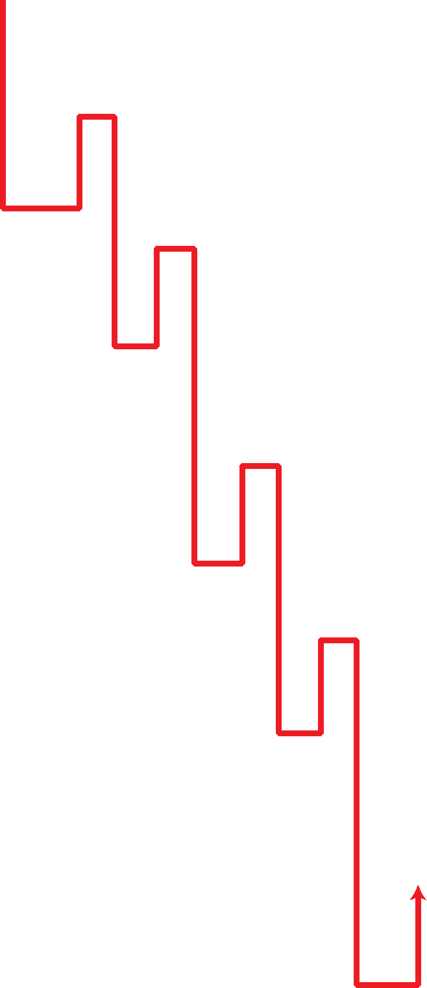
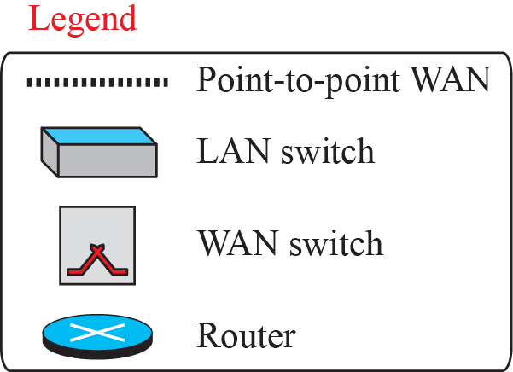
Figure 18.1: Communication at the network layer
18.6
Notes:
18.#

Slide 7
18.18.1 Packetizing
The first duty of the network layer is definitely packetizing: encapsulating the payload in a network-layer packet at the source and decapsulating the payload from the network-layer packet at the destination. In other words, one duty of the network layer is to carry a payload from the source to the destination without changing it or using it. The network layer is doing the service of a carrier such as the postal office, which is responsible for delivery of packages from a sender to a receiver without changing or using the contents.
18.7
Notes:
18.#

Slide 8
18.18.2 Routing and Forwarding
Other duties of the network layer, which are as important as the first, are routing and forwarding, which are directly related to each other.
18.8
Notes:
18.#

Slide 9
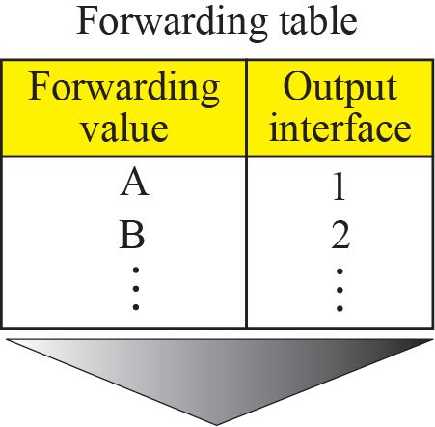
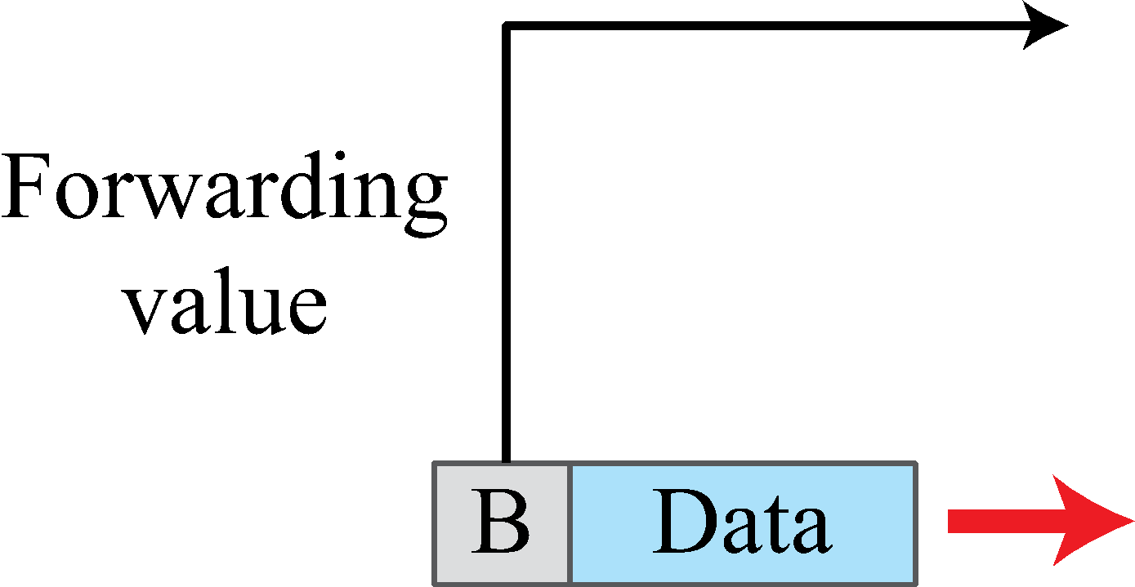
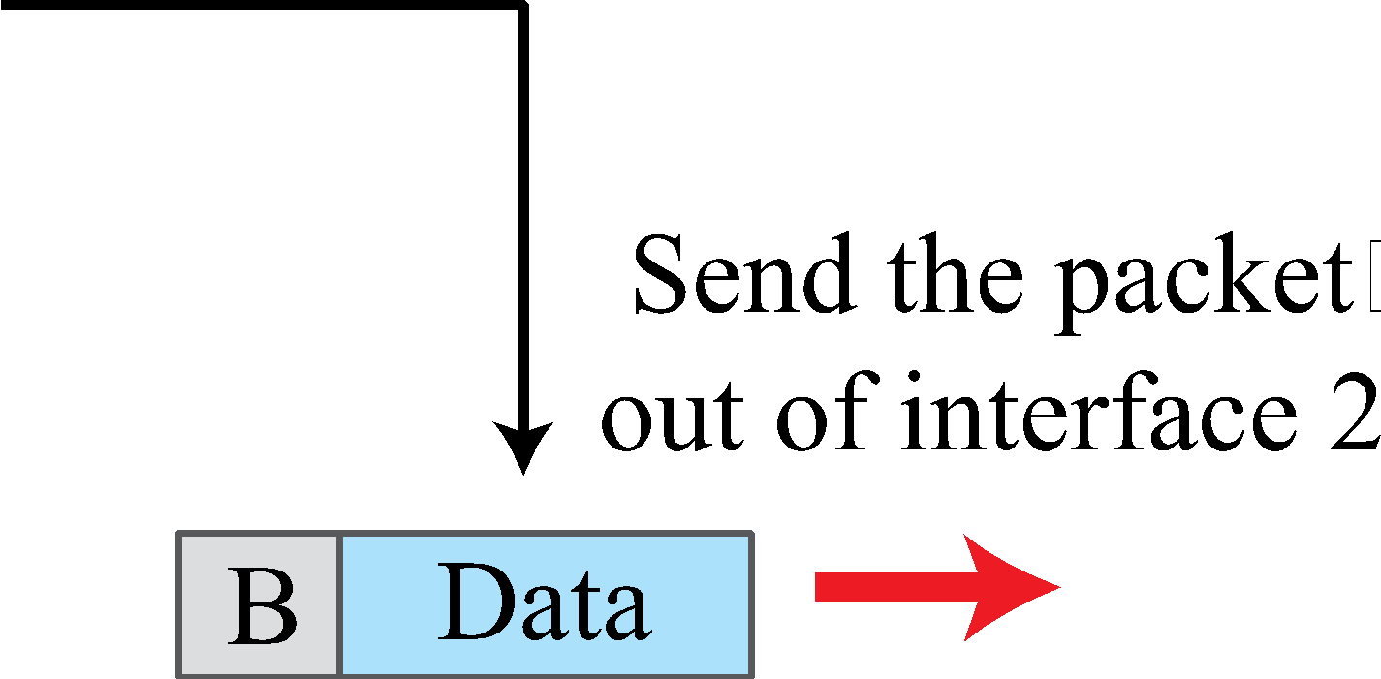
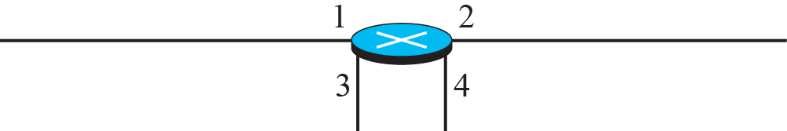
Figure 18.2: Forwarding process
18.9
Notes:
18.#

Slide 10
18.18.3 Other Services
Let us briefly discuss other services expected from the network layer.
1.Error control=min error control
2.Flow control=packet is go to router to router
3.Connection control=major issue= i.e packet miss
4.Quality of service=Data goes to reliable data goes to receiver definitely
Router send ICMP packet to search destination is reliable or not or we
send configuration (time to reach etc.)
18.10
Notes:
18.#

Slide 11
18-2 PACKET SWITCHING
From the discussion of routing and forwarding in the previous section, we infer that a kind of switching occurs at the network layer. A router, in fact, is a switch that creates a connection between an input port and an output port (or a set of output ports), just as an electrical switch connects the input to the output to let electricity flow.
18.11
Notes:
18.#

Slide 12
18.2.1 Datagram Approach
When the Internet started, to make it simple, the network layer was designed to provide a connectionless service in which the network-layer protocol treats each packet independently, with each packet having no relationship to any other packet. The idea was that the network layer is only responsible for delivery of packets from the source to the destination. In this approach, the packets in a message may or may not travel the same path to their destination. Figure 18.3 shows the idea..
18.12
Notes:
18.#

Slide 13
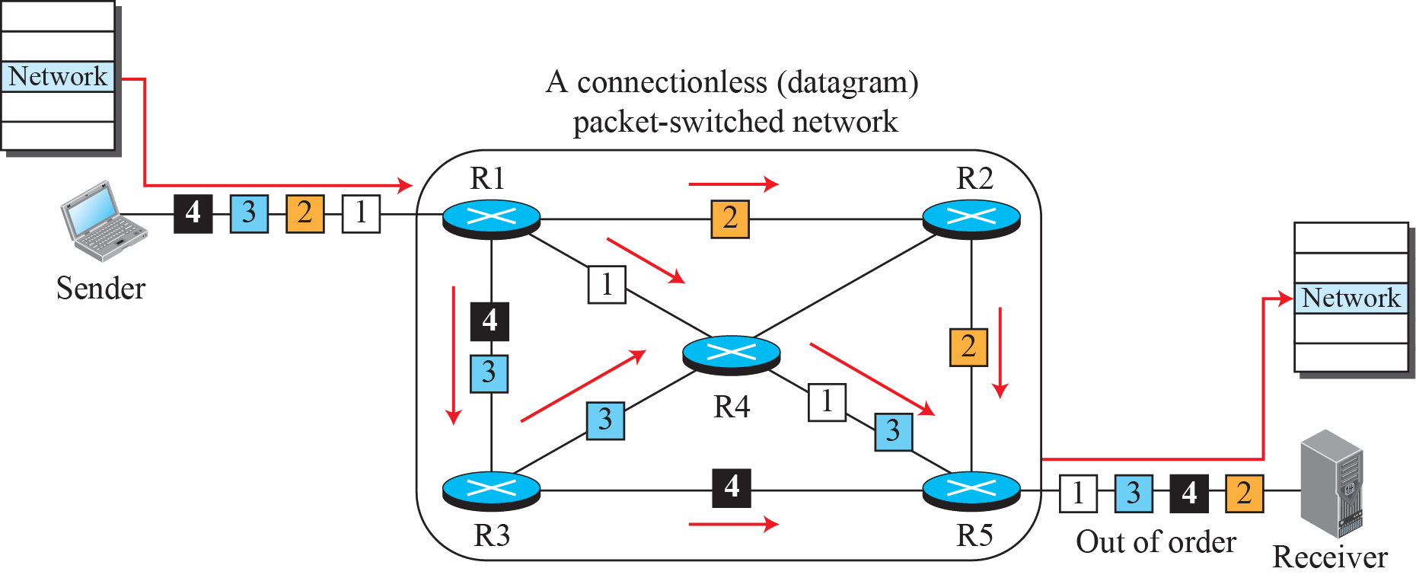
Figure 18.3: A connectionless packet-switched network
It is not necessary that the order of sending packet is also same in the receiver side
18.13
Notes:
18.#

Slide 14
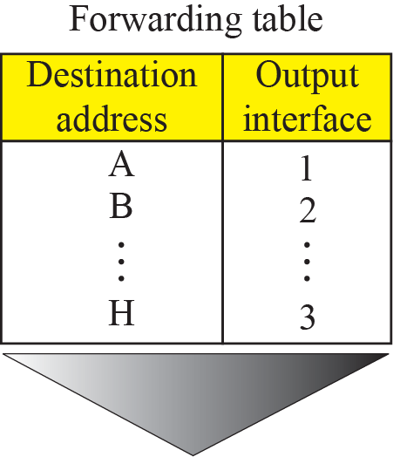
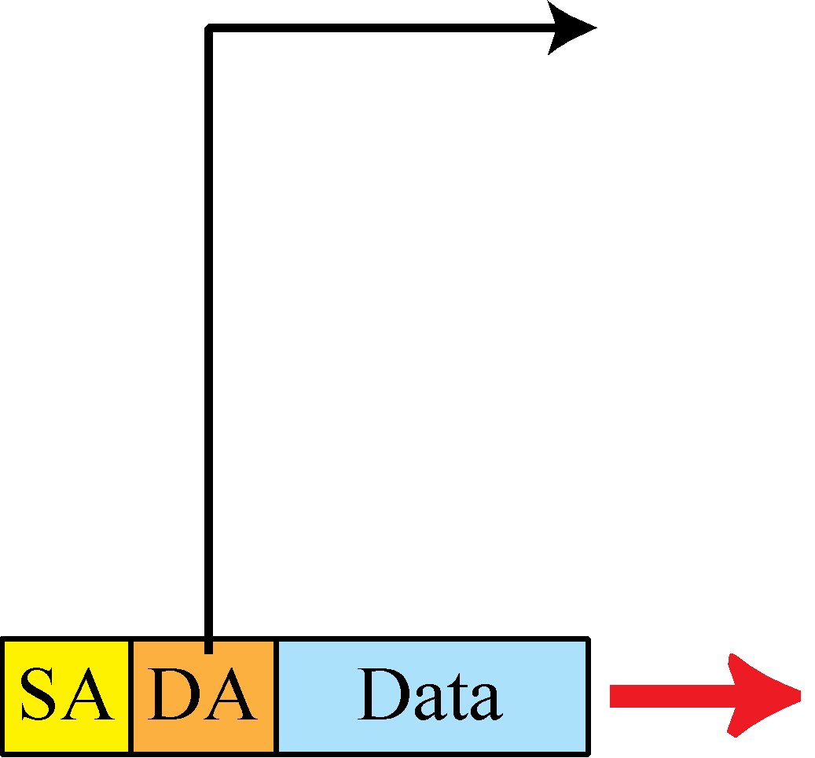
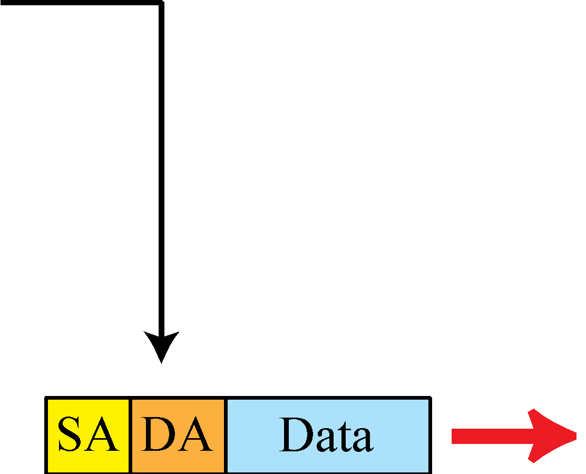
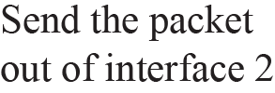
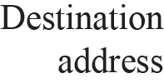
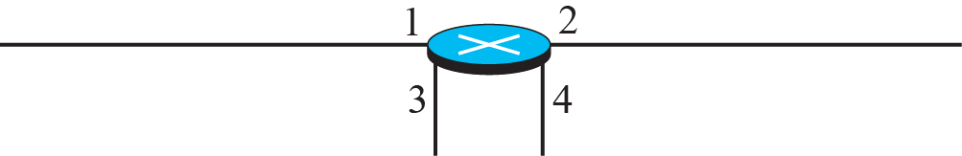
Figure 18.4: Forwarding process in a router when used in a
connectionless network
Source address ,Destination address
18.14
Notes:
18.#

Slide 15
18.2.2 Virtual-Circuit Approach
In a connection-oriented service (also called virtual-circuit approach), there is a relationship between all packets belonging to a message. Before all datagrams in a message can be sent, a virtual connection should be set up to define the path for the datagrams. After connection setup, the datagrams can all follow the same path. In this type of service, not only must the packet contain the source and destination addresses, it must also contain a flow label, a virtual circuit identifier that defines the virtual path the packet should follow.
18.15
Notes:
18.#

Slide 16
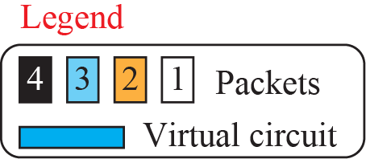
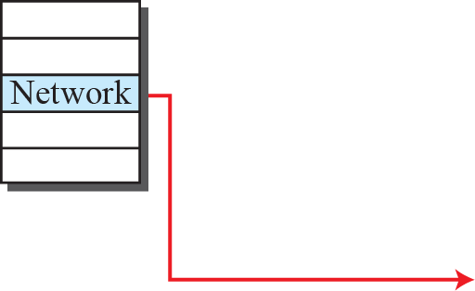
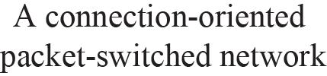

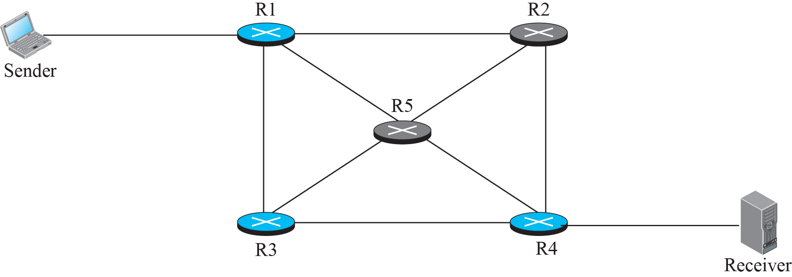
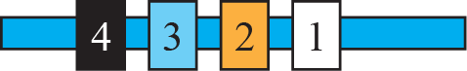

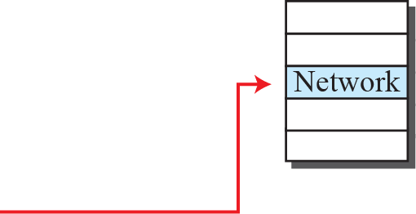
Figure 18.5: A virtual-circuit packet-switched network
18.16
Notes:
18.#

Slide 17
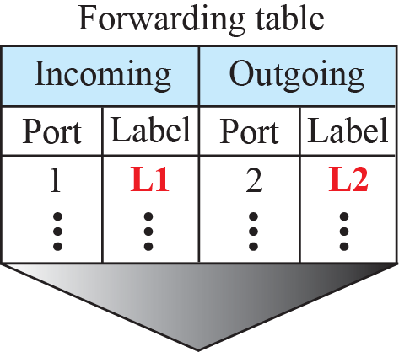
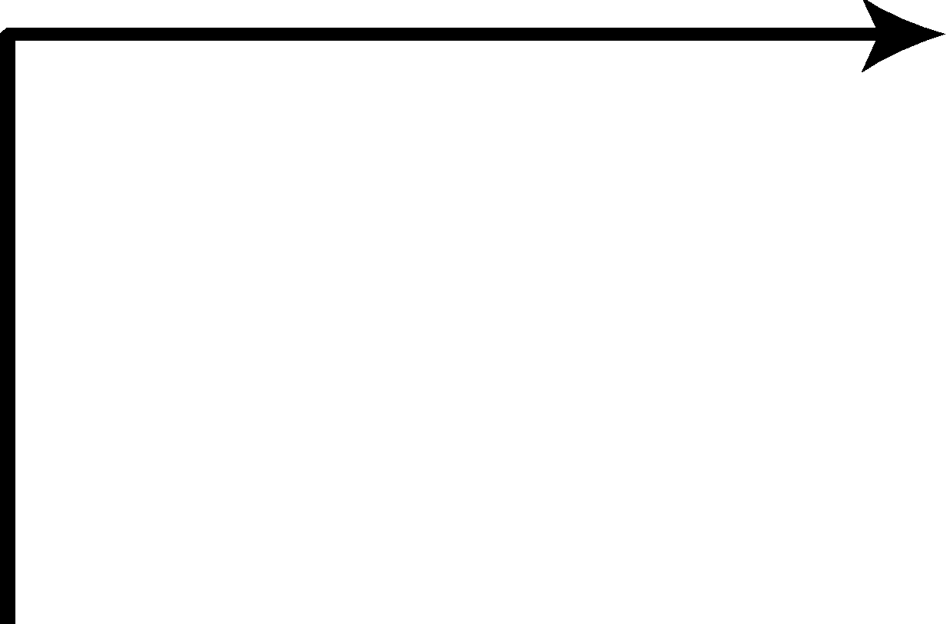
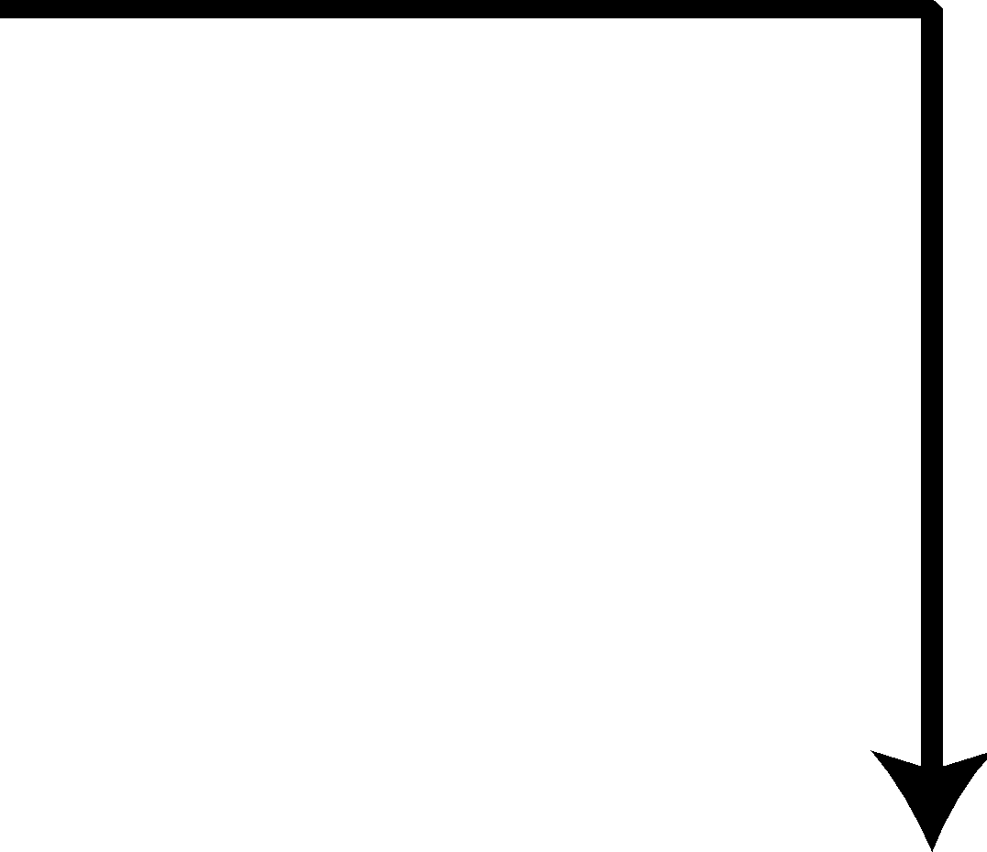
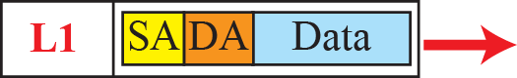

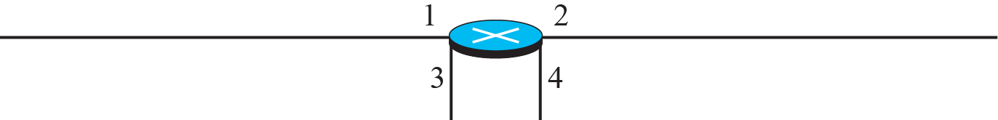


Figure 18.6: Forwarding process in a router when used in a virtual
circuit network
18.17
Notes:
18.#

Slide 18
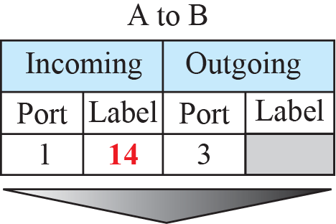
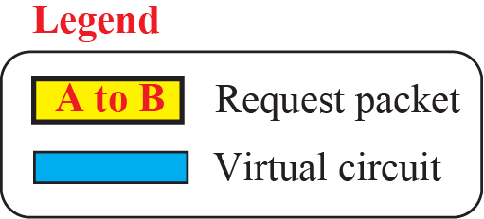
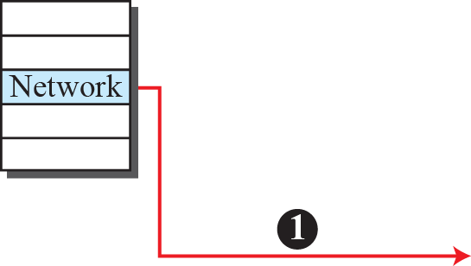
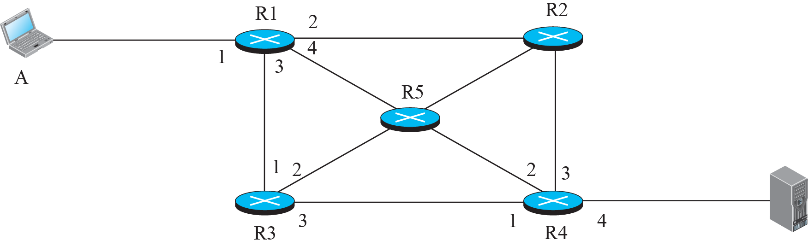

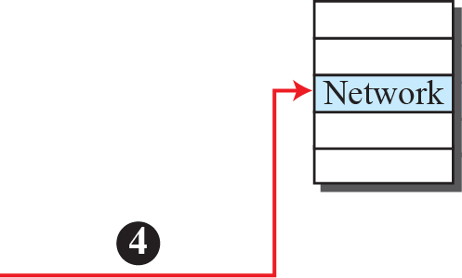

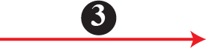

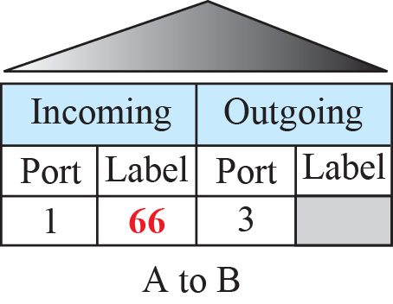
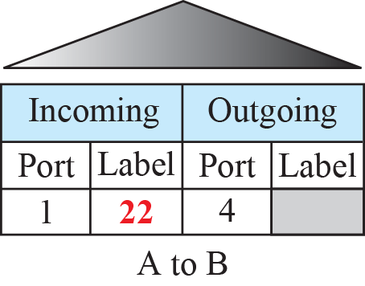
Figure 18.7: Sending request packet in a virtual-circuit network
18.18
Notes:
18.#

Slide 19
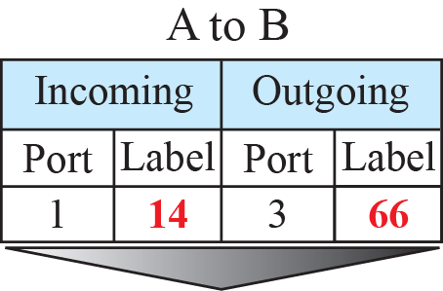
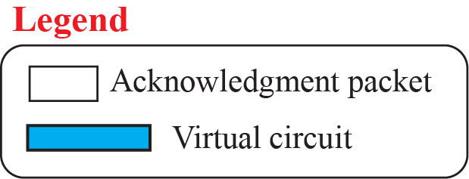
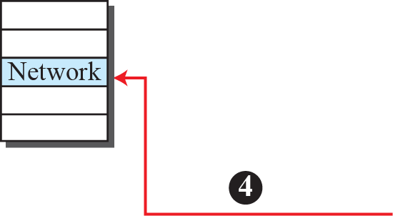
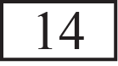
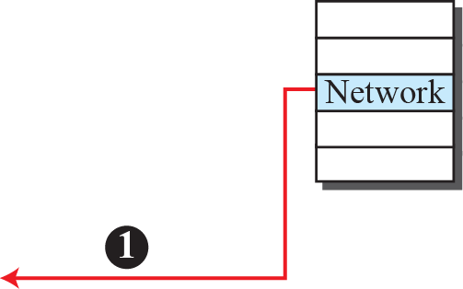

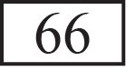

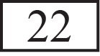

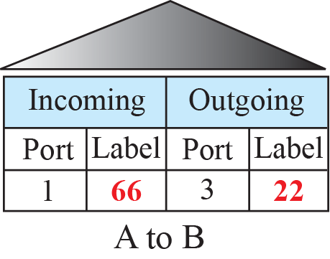
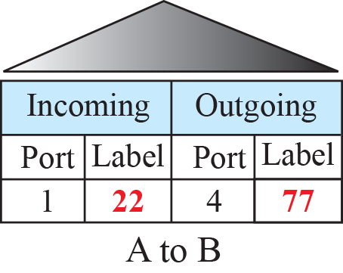
Figure 18.8: Sending acknowledgments in a virtual-circuit network
Incoming label sets
when we make connection
18.19
Notes:
18.#

Slide 20
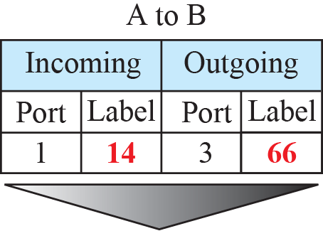
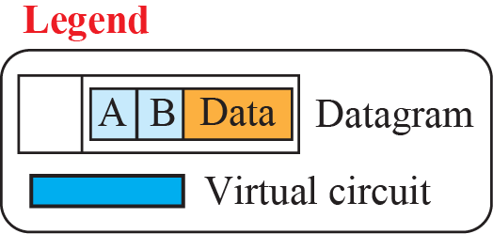
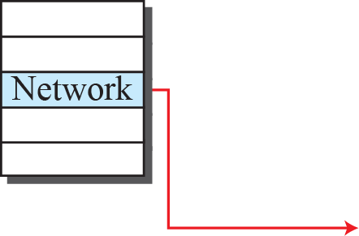
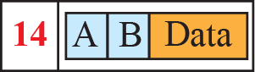
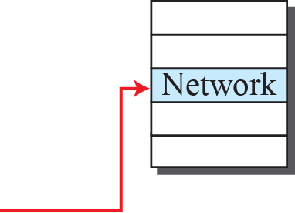
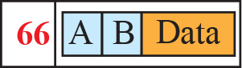
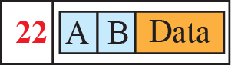



Figure 18.9: Flow of one packet in an established virtual circuit
Outgoing label is set
When ACK received
By B ki connection
Is set
After set all start data
sending
18.20
Notes:
18.#

Slide 21
18-3 NETWORK-LAYER PERFORMANCE
The upper-layer protocols that use the service of the network layer expect to receive an ideal service, but the network layer is not perfect. The performance of a network can be measured in terms of delay, throughput, and packet loss. Congestion control is an issue that can improve the performance.
18.21
Notes:
18.#

Slide 22
18.3.1 Delay
All of us expect instantaneous response from a network, but a packet, from its source to its destination, encounters delays. The delays in a network can be divided into four types: transmission delay, propagation delay, processing delay, and queuing delay. Let us first discuss each of these delay types and then show how to calculate a packet delay from the source to the destination..
18.22
Notes:
18.#

Slide 23


Slide 24
18.3.2 Throughput
Throughput at any point in a network is defined as the number of bits passing through the point in a second, which is actually the transmission rate of data at that point. In a path from source to destination, a packet may pass through several links (networks), each with a different transmission rate. How, then, can we determine the throughput of the whole path? To see the situation, assume that we have three links, each with a different transmission rate, as shown in Figure 18.10.
18.24
Notes:
18.#

Slide 25




Figure 18.10: Throughput in a path with three links in a series
Throughput=min(TR₁,TR₂--------TR_{n})
=min(200,100,150)=100 KBPS
18.25
Notes:
18.#

Slide 26

Figure 18.11: A path through the Internet backbone
18.26
Notes:
18.#

Slide 27

Figure 18.12: Effect of throughput in shared links
18.27
Notes:
18.#

Slide 28
18.3.3 Packet Loss
Another issue that severely affects the performance of communication is the number of packets lost during transmission. When a router receives a packet while processing another packet, the received packet needs to be stored in the input buffer waiting for its turn. A router, however, has an input buffer with a limited size. A time may come when the buffer is full and the next packet needs to be dropped. The effect of packet loss on the Internet network layer is that the packet needs to be resent, which in turn may create overflow and cause more packet loss.
18.28
Notes:
18.#

Slide 29
18.3.4 Congestion Control
Congestion control is a mechanism for improving performance. In Chapter 23, we will discuss congestion at the transport layer. Although congestion at the network layer is not explicitly addressed in the Internet model, the study of congestion at this layer may help us to better understand the cause of congestion at the transport layer and find possible remedies to be used at the network layer. Congestion at the network layer is related to two issues, throughput and delay, which we discussed in the previous section.
18.29
Notes:
18.#

Slide 30


Figure 18.13. Packet delay and throughput as functions of load
18.30
Notes:
18.#

Slide 31


Slide 32


Slide 33


Figure 18.14: Backpressure method for alleviating congestion
When it is full it start discard packets and send
signal to
Previous node that don’t send data
Then it stop sending data
18.33
Notes:
18.#

Slide 34

Figure 4.15: Choke packet
ICMP Packet to send source I am choke don’t send data
18.34
Notes:
18.#

Slide 35


Slide 36
18-4 IPv4 ADDRESSES
The identifier used in the IP layer of the TCP/IP protocol suite to identify the connection of each device to the Internet is called the Internet address or IP address. An IPv4 address is a 32-bit address that uniquely and universally defines the connection of a host or a router to the Internet. The IP address is the address of the connection, not the host or the router.
18.36
Notes:
18.#

Slide 37
18.4.1 Address Space
A protocol like IPv4 that defines addresses has an address space. An address space is the total number of addresses used by the protocol. If a protocol uses b bits to define an address, the address space is 2b because each bit can have two different values (0 or 1). IPv4 uses 32-bit addresses, which means that the address space is 2³² or 4,294,967,296 (more than four billion). If there were no restrictions, more than 4 billion devices could be connected to the Internet.
18.37
Notes:
18.#

Slide 38


Figure 18.16: Three different notations in IPv4 addressing
18.38
Notes:
18.#

Slide 39





Figure 18.17: Hierarchy in addressing
18.39
Notes:
18.#

Slide 40
18.4.2 Classful Addressing
When the Internet started, an IPv4 address was designed with a fixed-length prefix, but to accommodate both small and large networks, three fixed-length prefixes were designed instead of one (n = 8, n = 16, and n = 24). The whole address space was divided into five classes (class A, B, C, D, and E), as shown in Figure 18.18. This scheme is referred to as classful addressing. Although classful addressing belongs to the past, it helps us to understand classless addressing, discussed later.
18.40
Notes:
18.#

Slide 41



Figure 18.18: Occupation of the address space in classful addressing
All zero after prefix All zero before
suffix
Network Host
18.41
Notes:
18.#

Slide 42
18.4.3 Classless Addressing
With the growth of the Internet, it was clear that a larger address space was needed as a long-term solution. The larger address space, however, requires that the length of IP addresses also be increased, which means the format of the IP packets needs to be changed. Although the long-range solution has already been devised and is called IPv6, a short-term solution was also devised to use the same address space but to change the distribution of addresses to provide a fair share to each organization. The short-term solution still uses IPv4 addresses, but it is called classless addressing.
18.42
Notes:
18.#

Slide 43

Figure 18.19: Variable-length blocks in classless addressing
18.43
Notes:
18.#

Slide 44


Figure 18.20: Slash notation (CIDR)
Network layer host
32-8=24 2²⁴
32-12=20 2²⁰
32-25=7 2⁷
=2^{32-n}
18.44
Notes:
18.#

Slide 45




Figure 18.21: Information extraction in classless addressing
Set all suffix bits
to 0s
Set all suffix bits
to 1s
18.45
Notes:
18.#

Slide 46
Example 18.1
A classless address is given as 167.199.170.82/27. We can find the above three pieces of information as follows. The number of addresses in the network is 2^{32− n} = 2⁵ = 32 addresses. The first address can be found by keeping the first 27 bits and changing the rest of the bits to 0s.
The last address can be found by keeping the first 27 bits and changing the rest of the bits to 1s.
18.46
Notes:
46

Slide 47

Example 18.2
We repeat Example 18.1 using the mask. The mask in dotted-decimal notation is 256.256.256.224 The AND, OR, and NOT operations can be applied to individual bytes using calculators and applets at the book website.
11111111.11111111.11111111.11100000 Address=10100111.11000111.10101010.01010010
00000000.00000000.00000000.00011111=Not mask= 11111111.11111111.11111111.11100000
+1 first= 10100111.11000111.10101010.01000000
00000000.00000000.00000000.00100000=32 addresss
10100111.11000111.10101010.01010010=address
00000000.00000000.00000000.00011111=Not mask
10100111.11000111.10101010.010111111=last
18.47
Notes:
47

Slide 48

Example 18.3
In classless addressing, an address cannot per se define the block the address belongs to. For example, the address 230.8.24.56 can belong to many blocks. Some of them are shown below with the value of the prefix associated with that block.
18.48
Notes:
48

Slide 49


Figure 18.22: Network address
18.49
Notes:
18.#

Slide 50
Example 18.4
An ISP has requested a block of 1000 addresses. Since 1000 is not a power of 2, 1024 addresses are granted. The prefix length is calculated as n = 32 − log₂1024 = 22. An available block, 18.14.12.0/22, is granted to the ISP. It can be seen that the first address in decimal is 302,910,464, which is divisible by 1024.
First address=(prefix in decimal)*2^{32-n}=(prefix in decimal)*N
Perfix length of each subnetwork=32-log₂(Block of addresses)
18.50
Notes:
50

Slide 51
Example 18.5
An organization is granted a block of addresses with the beginning address 14.24.74.0/24. The organization needs to have 3 subblocks of addresses to use in its three subnets: one subblock of 10 addresses, one subblock of 60 addresses, and one subblock of 120 addresses. Design the subblocks.
Solution
There are 2^{32– 24} = 256 addresses in this block. The first address is 14.24.74.0/24; the last address is 14.24.74.255/24. To satisfy the third requirement, we assign addresses to subblocks, starting with the largest and ending with the smallest one.
18.51
Notes:
51

Slide 52
Example 18.5 (continued)
a. The number of addresses in the largest subblock, which requires 120 addresses, is not a power of 2. We allocate 128 addresses. The subnet mask for this subnet can be found as n₁ = 32 − log₂ 128 = 25. The first address in this block is 14.24.74.0/25; the last address is 14.24.74.127/25.
b. The number of addresses in the second largest subblock, which requires 60 addresses, is not a power of 2 either. We allocate 64 addresses. The subnet mask for this subnet can be found as n₂ = 32 − log₂ 64 = 26. The first address in this block is 14.24.74.128/26; the last address is 14.24.74.191/26.
18.52
Notes:
52

Slide 53
Example 18.5 (continued)
c. The number of addresses in the largest subblock, which requires 120 addresses, is not a power of 2. We allocate 128 addresses. The subnet mask for this subnet can be found as n₁ = 32 − log₂ 128 = 25. The first address in this block is 14.24.74.192/28; the last address is 14.24.74.207/28.
If we add all addresses in the previous subblocks, the result is 208 addresses, which means 48 addresses are left in reserve. The first address in this range is 14.24.74.208. The last address is 14.24.74.255. We don’t know about the prefix length yet. Figure 18.23 shows the configuration of blocks. We have shown the first address in each block.
18.53
Notes:
53

Slide 54








Figure 18.23: Solution to Example 4.5
18.54
Notes:
18.#

Slide 55
Example 18.6
Figure 18.24 shows how four small blocks of addresses are assigned to four organizations by an ISP. The ISP combines these four blocks into one single block and advertises the larger block to the rest of the world. Any packet destined for this larger block should be sent to this ISP. It is the responsibility of the ISP to forward the packet to the appropriate organization. This is similar to routing we can find in a postal network. All packages coming from outside a country are sent first to the capital and then distributed to the corresponding destination.
18.55
Notes:
55

Slide 56



Figure 18.24: Example of address aggregation
18.56
Notes:
18.#

Slide 57
18.4.4 DHCP
After a block of addresses are assigned to an organization, the network administration can manually assign addresses to the individual hosts or routers. However, address assignment in an organization can be done automatically using the Dynamic Host Configuration Protocol (DHCP). DHCP is an application-layer program, using the client-server paradigm, that actually helps TCP/IP at the network layer.
18.57
Notes:
18.#

Slide 58


Figure 18.25: DHCP message format
18.58
Notes:
18.#

Slide 59



Figure 18.26: Option format
18.59
Notes:
18.#

Slide 60








Figure 18.27: Operation of DHCP
18.60
Notes:
18.#

Slide 61

Figure 18.28: FSM for the DHCP client
18.61
Notes:
18.#

Slide 62
18.4.5 NAT
In most situations, only a portion of computers in a small network need access to the Internet simultaneously. A technology that can provide the mapping between the private and universal addresses, and at the same time support virtual private networks, which we discuss in Chapter 32, is Network Address Translation (NAT). The technology allows a site to use a set of private addresses for internal communication and a set of global Internet addresses (at least one) for communication with the rest of the world.
18.62
Notes:
18.#

Slide 63

Figure 18.29: NAT
Local IP addresses=192
10
172
18.63
Notes:
18.#

Slide 64





Figure 18.30: Address translation
18.64
Notes:
18.#

Slide 65

Figure 18.31: Translation
18.65
Notes:
18.#

Slide 66


Table 18.1: Five-column translation table
18.66
Notes:
66

Slide 67
18-5 FORWARDING OF IP PACKETS
We discussed the concept of forwarding at the network layer earlier in this chapter. In this section, we extend the concept to include the role of IP addresses in forwarding. As we discussed before, forwarding means to place the packet in its route to its destination.
18.67
Notes:
18.#

Slide 68
18.5.1 Destination Address Forwarding
We first discuss forwarding based on the destination address. This is a traditional approach, which is prevalent today. In this case, forwarding requires a host or a router to have a forwarding table. When a host has a packet to send or when a router has received a packet to be forwarded, it looks at this table to find the next hop to deliver the packet to.
18.68
Notes:
18.#

Slide 69

Figure 18.32: Simplified forwarding module in classless address
18.69
Notes:
18.#

Slide 70

Example 18.7
Make a forwarding table for router R1 using the configuration in Figure 18.33.
Solution
Table 18.2 shows the corresponding table.
Table 18.2: Forwarding table for router R1 in Figure 4.46
18.70
Notes:
70

Slide 71

Figure 18.33: Configuration for Example 4.7
18.71
Notes:
18.#

Slide 72

Example 18.8
Instead of Table 18.2, we can use Table 18.3, in which the network address/mask is given in bits.
Table 18.3: Forwarding table for router R1 using prefix bits
When a packet arrives whose leftmost 26 bits in the destination address match the bits in the first row, the packet is sent out from interface m2. And so on.
18.72
Notes:
72

Slide 73
Example 18.9
Show the forwarding process if a packet arrives at R1 in Figure 18.33 with the destination address 180.70.65.140.
Solution
The router performs the following steps:
1. The first mask (/26) is applied to the destination address. The result is 180.70.65.128, which does not match the corresponding network address.
2. The second mask (/25) is applied to the destination address. The result is 180.70.65.128, which matches the corresponding network address. The next-hop address and the interface number m0 are extracted for forwarding the packet (see Chapter 5).
18.73
Notes:
73

Slide 74





Figure 18.34: Address aggregation
18.74
Notes:
18.#

Slide 75



Figure 18.35: Longest mask matching
18.75
Notes:
18.#

Slide 76
Example 18.10
As an example of hierarchical routing, let us consider Figure 18.36. A regional ISP is granted 16,384 addresses starting from 120.14.64.0. The regional ISP has decided to divide this block into 4 subblocks, each with 4096 addresses. Three of these subblocks are assigned to three local ISPs, the second subblock is reserved for future use. Note that the mask for each block is /20 because the original block with mask /18 is divided into 4 blocks.
The figure also shows how local and small ISPs have assigned addresses.
18.76
Notes:
76

Slide 77

Figure 18.35: Hierarchical routing with ISPs
18.77
Notes:
18.#

Slide 78
18.5.2 Forwarding Based on Label
In the 1980s, an effort started to somehow change IP to behave like a connection-oriented protocol in which the routing is replaced by switching. As we discussed earlier In a connection-oriented network (virtual-circuit approach), a switch forwards a packet based on the label attached to the packet. Routing is normally based on searching the contents of a table; switching can be done by accessing a table using an index. In other words, routing involves searching; switching involves accessing..
18.78
Notes:
18.#

Slide 79
Example 18.11
Figure 18.37 shows a simple example of searching in a forwarding table using the longest mask algorithm. Although there are some more efficient algorithms today, the principle is the same.
When the forwarding algorithm gets the destination address of the packet, it needs to delve into the mask column. For each entry, it needs to apply the mask to find the destination
network address. It then needs to check the network addresses in the table until it finds the match. The router then extracts the next-hop address and the interface number to be delivered to the data-link layer.
18.79
Notes:
79

Slide 80









Figure 18.37: Example 18.11: Forwarding based on destination address
18.80
Notes:
18.#

Slide 81
Example 18.12
Figure 18.38 shows a simple example of using a label to access a switching table. Since the labels are used as the index to the table, finding the information in the table is immediate.
18.81
Notes:
81

Slide 82








Figure 18.38: Example 18.12: Forwarding based on label
18.82
Notes:
18.#

Slide 83

Figure 18.39: MPLS header added to an IP packet
18.83
Notes:
18.#

Slide 84

Figure 18.40: MPLS header made of a stack of labels
18.84
Notes:
18.#

Slide 85
18.5.3 Routers as Packet Switches
As we may have guessed by now, the packet switches that are used in the network layer are called routers. Routers can be configured to act as either a datagram switch or a virtual-circuit switch. We have discussed the structure of a packet-switch in Chapter 8. The discussion in that chapter can be applied to any router used in the Internet.
18.85
Notes:
18.#

Slide 86


Slide 87


Slide 88


Slide 89


Slide 90


Slide 91


